Slide 1
1 John 5:7-8
The original text

Slide 2
5:7 For there are three that bear record in heaven, the Father, the Word, and the Holy Ghost: and these three are one.
5:8 And there are three that bear witness in earth, the Spirit, and the water, and the blood: and these three agree in one.
This is the text that appears in English in the King James Version.

Slide 3
5:7 For there are three that bear record in heaven, the Father, the Word, and the Holy Ghost: and these three are one.
5:8 And there are three that bear witness in earth, the Spirit, and the water, and the blood: and these three agree in one.
This is the text that appears in English in the King James Version.
However, the crossed-out words have disappeared from modern versions.
Why? What is the correct translation of these verses?

Slide 4
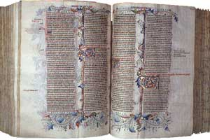
The words “in heaven, the Father, the Word, and the Holy Ghost: and these three are one. And there are three that bear witness in earth” were not written by John. However, they were present in the most widespread translation of the Bible until the sixteenth century: the Latin Vulgate.
Why did they appear in this version if they were not in the original?

Slide 5
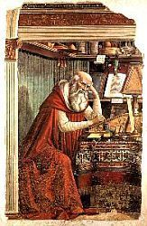
In the year 382 Pope Damasus I commissioned Jerome to translate the Bible into Vulgar Latin (the Latin Vulgate).
Neither in the original version nor in its subsequent editions did the words in question appear.

Slide 6

For there are three that bear record
the Spirit, and the water, and the blood: and these three agree in one
in heaven, the Father, the Word, and the Holy Ghost: and these three are one. And there are three that bear witness in earth
Since the printing press did not yet exist, copies were made by hand and it was common to leave words when copying, or to make mistakes.
These errors were noted and corrected in the margin of the text. But personal comments by the writer or reader were also written in the margin.
One of these comments was misinterpreted by a later copyist, as he believed that it was the rectification of an error by a previous copyist.
This deviation was incorporated in successive copies until, by the fifteenth century, it was already an integral part of the text of the Vulgate.

Slide 7
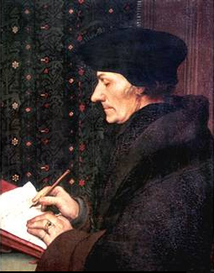
In 1516 Erasmus of Rotterdam published the New Testament in Greek, which did not include the texts cited.
When the Church called his attention to this omission (which disqualified the Vulgate), he explained that he had not found any original Greek text where these phrases were found, but that he was willing to include them if someone showed him a single one.

Slide 8
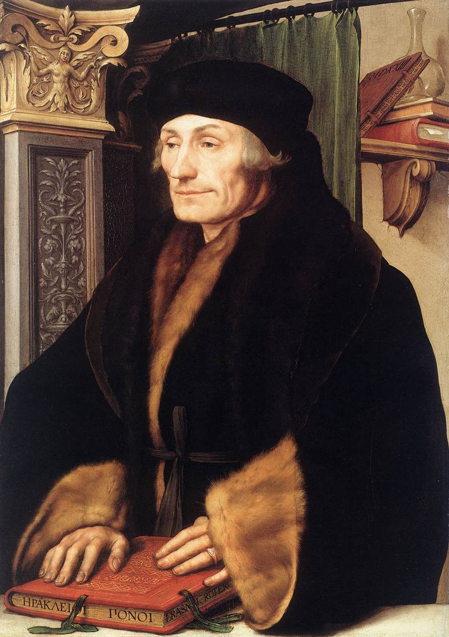
In 1520 an anonymous Franciscan monk published a manuscript in Greek containing the disputed texts, which he himself had translated from Latin.
As in those times the archaeological criteria were scarce to confirm or deny such a text, Erasmus accepted it and added the words in his third edition, published in 1522.

Slide 9
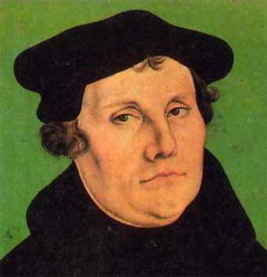
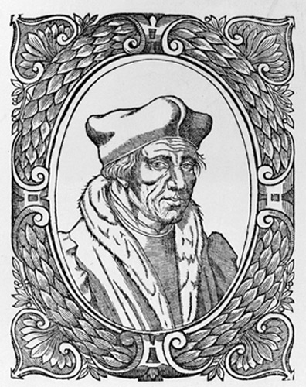
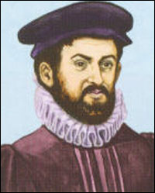
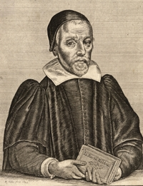
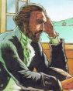
This Greek version of the New Testament served as the basis for the translation of the Bible into several languages during the Reformation.
German
Martin Luther
1522
French
Lefèvre d’Étaples
1525
Spanish
Casiodoro de Reina
1569
Italian
Giovanni Diodati
1607
English
Versión King James
1611
Portuguese
João Ferreira de Almeida
1681
Martin Luther
Lefèvre d’Étaples
Casiodoro de Reina
Giovanni Diodati
João Ferreira de Almeida

Slide 10
Newer versions have already fixed the bug.
“There are three witnesses, the Spirit, the water, and the blood; and these three agree” (Revised Standard Version)
“For there are three that testify: the Spirit, the water and the blood; and the three are in agreement” (New International Version)
“So we have these three witnesses— the Spirit, the water, and the blood—and all three agree” (New Living Translation)
“οτι τρεις εισιν οι μαρτυρουντες, το πνευμα και το υδωρ και το αιμα”
“for there are three that testify, the Spirit and the water and the blood” (Nestle Greek text)

